Slide 1
Module 1: Introduction to Microsoft Power Platform

Slide 2
Module agenda
Microsoft Power Platform overview

Slide 3
Lesson 1: Microsoft Power Platform overview

Slide 4
Lesson introduction
In this lesson, you will:
Learn the components and features of Microsoft Power Platform
Identify when to use each Microsoft Power Platform component application to create business solutions
Learn the value of using Microsoft Power Platform to create business solutions

Slide 5


Microsoft Power Platform
The low-code platform that spans Office 365, Azure, Dynamics 365, and standalone applications
Power BI
Business analytics
Power Apps
Application development
Power Automate
Process automation
Power Virtual Agents
Intelligent virtual agents
Data connectors
AI Builder
Dataverse
Notes:
Microsoft Power Platform is comprised of four key products: Power Apps, Power Automate, and Power BI and Power Virtual Agents.
Power Apps provides a rapid low code development environment for building custom apps for business needs. It has services, connectors, and a scalable data service and app platform (Dataverse) to allow simple integration and interaction with existing data. Power Apps enables the creation of web and mobile applications that run on all devices. People use apps for every area of their lives, and business should be no exception. Most out of the box solutions do not meet exact business needs or integrate well with other business programs. Power Apps eases users into app development with a simple interface so that every business user or pro developer can build custom apps.
Power Automate lets users create automated workflows between applications and services. It helps automate repetitive business processes such as communication, data collections, and decision approvals. If you have ever been performing a repetitive task for work and think, “This is so easy a monkey could do it,” Power Automate is your new best friend. Don't waste important productive hours on drafting the same email for a weekly update or walking approvals through. Not only for the individual user, Power Automate allows for the creation of enterprise-grade process automation. Power Automate's simple interface allows every level of user to automate work tasks from beginners to seasoned developers.
Power BI (Business Intelligence) is a business analytics service that delivers insights for analyzing data. It can share those insights through data visualizations which make up reports and dashboards to enable fast, informed decisions. Power BI scales across an organization, and it has built-in governance and security allowing businesses to focus on using data more than managing it. You can consider Power BI as the analysis and insights leg of Microsoft Power Platform. It takes business data and allows you to display it in ways that makes the most sense to users. A Power BI dashboard could potentially replace a standing meeting to report out on company metrics such as sales data, progress against goals, or employee performance.
Power Virtual Agents enables anyone to create powerful chatbots using a guided, no-code graphical interface, without the need for data scientists or developers. Power virtual agents addresses many of the major issues with chatbot building. It eliminates the gap between subject matter experts and the development teams building the chatbots. It removes the complexity of exposing teams to the nuances of conversational AI and the need to write complex code. It minimizes the IT effort required to deploy and maintain a custom conversational solution by empowering subject matter experts to build and maintain their own conversational solutions.

Slide 6
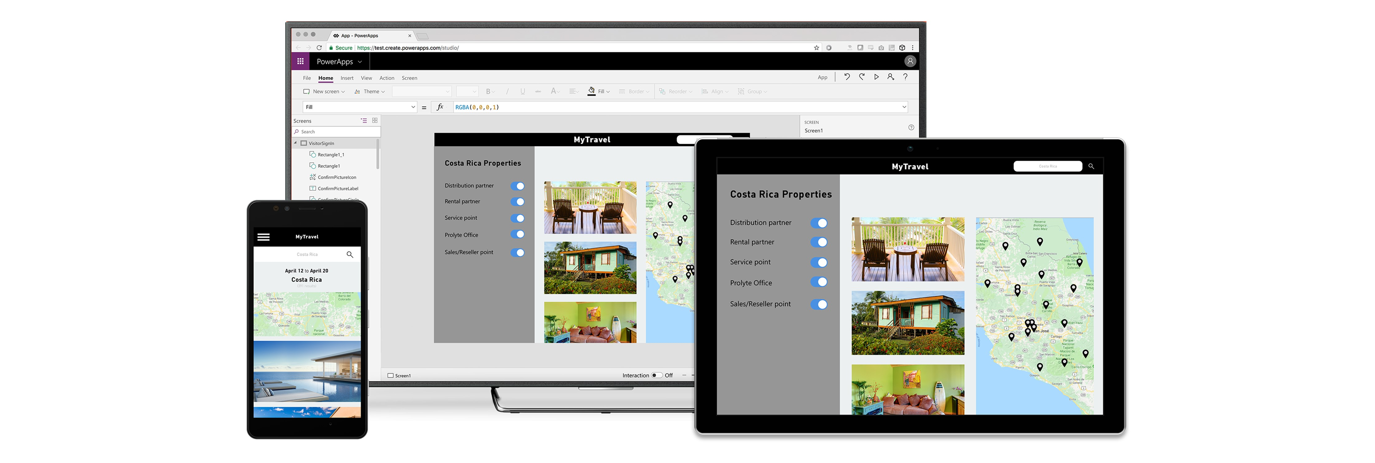
Build and consume solutions for web and mobile with Power Apps
Build highly customized task- and role-based canvas apps with data from one or multiple sources
Generate immersive model-driven apps, starting from your data model and business processes
Consume fully accessible apps across web and mobile, embedded or standalone, on any device
Notes:
Power Apps provides a rapid low code development environment for building custom apps for business needs. It has services, connectors, and a scalable data service and app platform (Dataverse) to allow simple integration and interaction with existing data. Power Apps enables the creation of web and mobile applications that run on all devices.
People use apps for every area of their lives, and business should be no exception. Most out of the box solutions do not meet exact business needs or integrate well with other business programs. Power Apps eases users into app development with a simple interface so that every business user or pro developer can build custom apps.

Slide 7
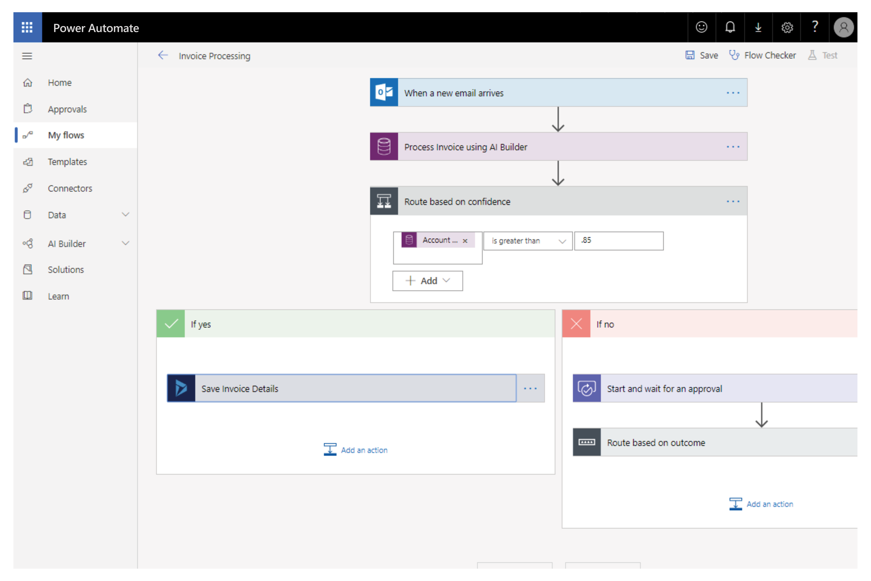
Automate and integrate business processes with Power Automate
Automate and model business processes across your apps and services
From simple automations to advanced scenarios with branches, loops, and more
Trigger actions, grant approvals, and get notifications right where you work
Automate legacy, on-prem and cloud-based applications and services
Notes:
Power Automate lets users create automated workflows between applications and services. It helps automate repetitive business processes such as communication, data collections, and decision approvals.
You can avoid wasting important productive hours on drafting the same email for a weekly update or walking approvals through. Not only for the individual user, Power Automate allows for the creation of enterprise-grade process automation. Power Automate's simple interface allows every level of user to automate work tasks from beginners to seasoned developers.

Slide 8
Gain insights from your data regardless of where it lives with Power BI
Connect to all your data and get a consolidated view across your business through a single pane of glass
Create ad-hoc analysis, live dashboards and interactive reports that are easy to consume on the web and across mobile devices
Build smart apps by infusing insights from your data and drive action with the power of Microsoft Power Platform
Notes:
Power BI (Business Intelligence) is a business analytics service that delivers insights for analyzing data. It can share those insights through data visualizations which make up reports and dashboards to enable fast, informed decisions. Power BI scales across an organization, and it has built-in governance and security allowing businesses to focus on using data more than managing it.
You can consider Power BI as the analysis and insights leg of Microsoft Power Platform. It takes business data and allows you to display it in ways that makes the most sense to users. A Power BI dashboard could potentially replace a standing meeting to report out on company metrics such as sales data, progress against goals, or employee performance.

Slide 9

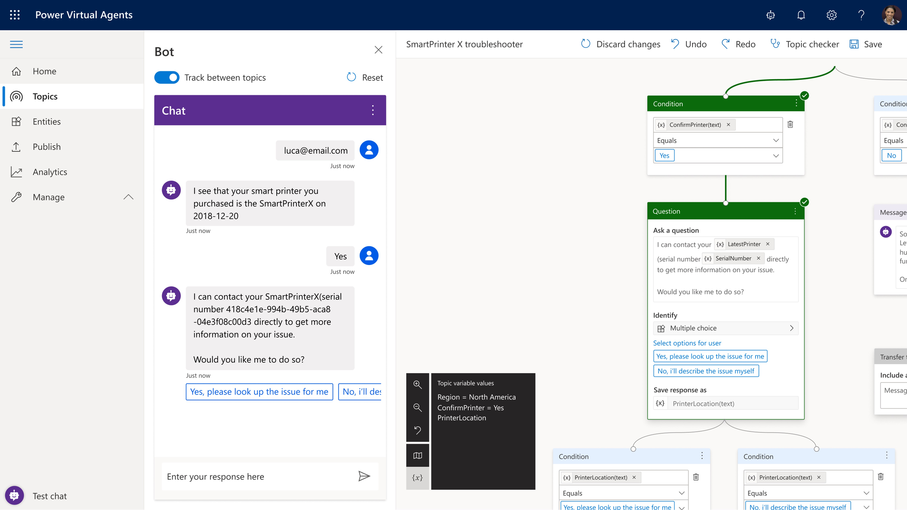
Build powerful chatbots with Power Virtual Agents
Enable subject matter experts to easily create powerful chatbots using a guided, no-code graphical interface—all without the need for data scientists or developers
Enable the virtual agent to act on the customer’s behalf. Easily integrate your virtual agent with hundreds of services and systems out of the box or create custom workflows
Keep an eye on how your virtual agent is performing by using conversational metrics and dashboards. Get in-depth AI-driven insights to improve bot performance
Notes:
Power Virtual Agents enables anyone to create powerful chatbots using a guided, no-code graphical interface, without the need for data scientists or developers.
Power virtual agents addresses many of the major issues with chatbot building. It eliminates the gap between subject matter experts and the development teams building the chatbots. It removes the complexity of exposing teams to the nuances of conversational AI and the need to write complex code. It minimizes the IT effort required to deploy and maintain a custom conversational solution by empowering subject matter experts to build and maintain their own conversational solutions.

Slide 10

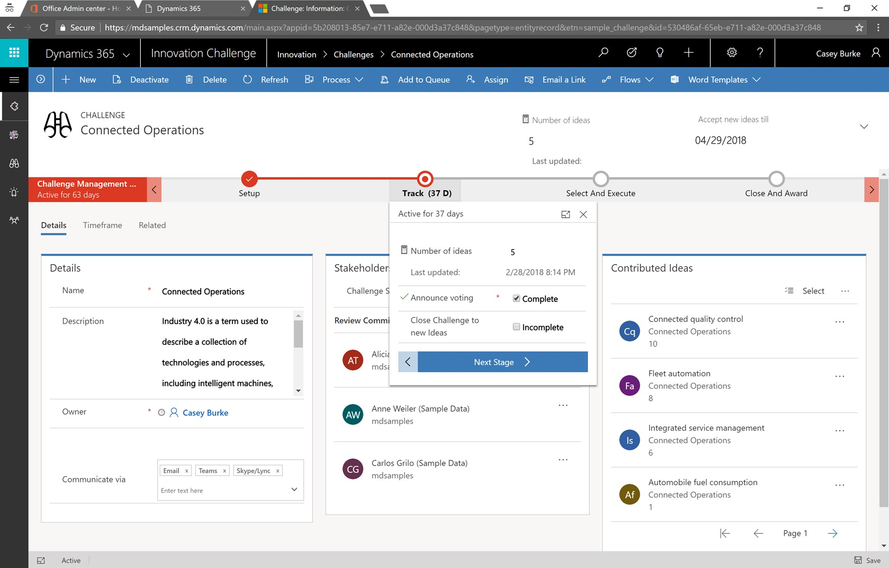
Put all your data to work with Dataverse
Jumpstart apps using a standardized data model with business logic, security and integration built-in
Extend to your own needs and integrate across your apps and services
Seamless Dynamics 365, Office 365, and Azure integration, augmented with data from industry partners
Notes:
Dataverse is a scalable data service and app platform which lets users securely store and manage data from multiple sources and integrate that data in business applications using a common data model to ensure ease and consistency to users. Dataverse is the common currency that enables the components of Microsoft Power Platform to work together. It’s the foundation that enables the consolidation, display, and manipulation of data.

Slide 11
Data connectors
Connectors are available for use in multiple products:
Power Automate
Power Apps
Logic Apps
Custom connectors:
An advantage of building custom connectors is that they can be used in different platforms, such as Power Apps, Power Automate, and Azure Logic Apps
It allow you to extend your app by calling a publicly available API, or a custom API you're hosting in a cloud provider, such as Azure.
You can create custom connectors using 3 different approaches:
Using a blank custom connector
From an OpenAPI definition
From a Postman collection
Notes:
Microsoft Power Platform is made powerful by its ability to leverage data across many platforms. To do this, components of Microsoft Power Platform use connectors. You can think of connectors as a bridge from your data source to your app or workflow which allows information to be conveyed back and forth. Connectors allow you to extend your business solutions across platforms and add functionality for your users, and Microsoft Power Platform has more than 275 connectors with the ability to build custom connectors as well.
It is important to note that premium connectors require a paid plan for use. The connector reference in the summary and resources unit lists all connectors and whether they are considered standard or premium. Custom connectors are also considered a premium feature.

Slide 12
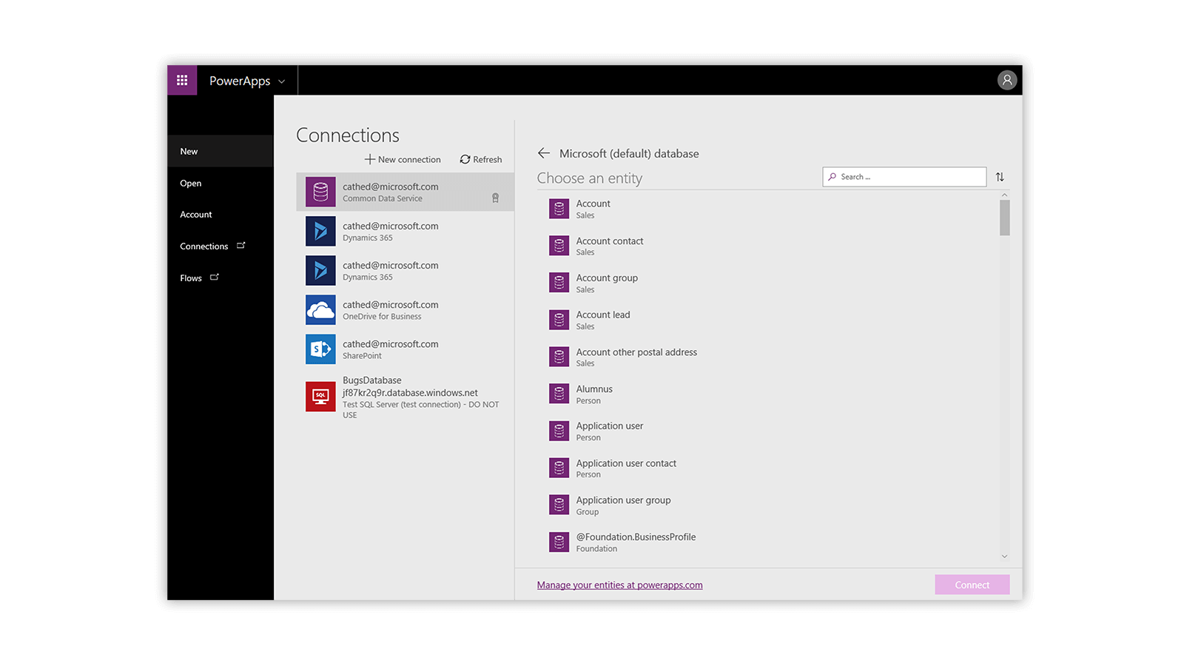
Data sources for connectors
The two types of data sources are:
Tabular data: A tabular data source is one that returns data in a structured table format
Function-based data: A function-based data source is one that uses functions to interact with the data source
Notes:
Both of these data source types are commonly used to bring data and additional functionality to your solutions.
As you can see, connecting to data sources allows you to integrate disparate parts of your business solutions to build them out cohesively.
Tabular data: A tabular data source is one that returns data in a structured table format. Power Apps can directly read and display these tables through galleries, forms, and other controls. Additionally, if the data source supports it, Power Apps can create, edit, and delete data from these data sources. Examples include Dataverse, SharePoint, and SQL Server.
Function-based data: A function-based data source is one that uses functions to interact with the data source. These functions can be used to return a table of data, but offer more extensive action such as the ability to send an email, update permissions, or create a calendar event. Examples include Office 365 Users, Project Online, and Azure Blob Storage.

Slide 13
Components of a connector
Once you have established a data source and configured your connector, there are two types of operations you can use:
Triggers prompt a flow to begin
Actions are prompted by the user or a trigger and allow interaction with your data source by some function
Notes:
Triggers are only used in Power Automate and prompt a flow to begin. Triggers can be time based, such as a flow which begins every day at 8:00 am, or they could be based off of an action like creating a new record in a table or receiving an email. You will always need a trigger to tell your workflow when to run.
Actions are used in Power Automate and Power Apps. Actions are prompted by the user or a trigger and allow interaction with your data source by some function. For example, an action would be sending an email in your workflow or app or writing a new line to a data source.

Slide 14
Data Loss Prevention, compliance, privacy, and accessibility
Data loss prevention policies:
Data loss prevention (DLP) policies can be scoped at the environment level or tenant level, offering flexibility to craft sensible policies that strike the right balance between protection and productivity.
Compliance and data privacy:
Microsoft is committed to the highest levels of trust, transparency, standards conformance, and regulatory compliance.
Data Protection
Resources to manage GDPR Compliance
Accessibility in Microsoft Power Platform:
Microsoft Power Platform is accessible and inclusive to all kinds of users all over the world.
An accessible canvas app will allow users with vision, hearing, and other impairments to successfully use the app.
Notes:
Data Protection:
Data as it is in transit between user devices and the Microsoft datacenters are secured. Connections established between customers and Microsoft datacenters are encrypted, and all public endpoints are secured using industry-standard TLS. TLS effectively establishes a security-enhanced browser to server connection to help ensure data confidentiality and integrity between desktops and datacenters. API access from the customer endpoint to the server is also similarly protected. Currently, TLS 1.2 (or higher) is required for accessing the server endpoints.
Resources to manage GDPR Compliance
The European Union General Data Protection Regulation (GDPR) is one of the newest privacy regulations enacted that gives rights to people to manage their personal data. A complete discussion of GDPR is beyond the scope of this content, however Microsoft Power Platform does fully support the GDPR. For more GDPR resources and information, visit the Trust Center at https://www.microsoft.com/TrustCenter/Privacy/gdpr/default.aspx .

Slide 15
Pulling it all together
Microsoft Power Platform helps to add value to any business by analyzing, acting and automating
Build custom apps in Power Apps
Automate processes with Power Automate
Analyze data with Power BI
Build powerful chatbots with Power Virtual Agents
Notes:
Although we live in a data driven world, your business can find it difficult to take advantage of the data you have access to. Sales, customer, and employee data should drive our business decisions, but where do we even start? Microsoft Power Platform can add value to any business by helping you to analyze, act, and automate. Act by building custom apps in Power Apps, automate processes based on the data you collect in Power Automation, and analyze the data you have collected in Power BI.
Consider a business that has IT equipment for general use. Currently equipment check-out is conducted by visiting the IT office and if the product is available, writing your name and the equipment name in a notebook. Employees may have to visit IT several times before equipment becomes available, and IT personnel must drop their tasks to check on equipment status or go to collect it for the employee. Sometimes employees hold onto the equipment longer than they intend and an IT personnel spends time tracking it down. In addition, important equipment information such as serial number, warranty details, and instructions for use are kept somewhere in the IT office. How can Microsoft Power Platform improve this process?
Power Apps allows us to build an app that has all equipment listed, the status of that equipment, and even important details such as use instructions. This way employees can check out available equipment, walk to IT at a specified pick up time where the equipment will be ready, and even access the use instructions or flag an equipment malfunction from their phone or tablet. Power Automate can read when equipment needs to be returned and send reminder emails out, or even a warning that the equipment is late being checked in. Users can see when equipment is booked through the app and request check out for a future date at which time Power Automate can send them a reminder to pick the equipment up and IT a reminder to have it ready. Power BI can take all the data generated from the app and analyze it to help you understand what equipment is used most often and by whom. This way you can decide if you need additional equipment, if some users or departments need dedicated equipment, and when your equipment has reached the end of its usefulness.
This is only one common scenario in which Microsoft Power Platform can transform the way businesses work. Consider your own business and what processes take up valuable time and are a burden to customers or employees. How can you leverage Microsoft Power Platform to improve them?

Slide 16
Module 1: Summary & knowledge check

Slide 17


Module 1 lab
Lab 1: Validate lab environment

Slide 18
Closing slide

